Slide 1
A Study of Social Factors in Activity-based Active Learning Class Correlating to Students Performance

Slide 2
Presentation Outline
Introducing the problem
Literature review on ABAL
Literature review of students’ social factors
Observation studies
Data analysis
Future work
Conclusion
Preliminary Discussion

Slide 3
What is an ABAL class?
ABAL – Activity-based Active Learning
It is one of the different forms of Active learning
Specializes in students’ learning process through activities

Slide 4
What is an ABAL?
ABAL based on 3 closely-knit iterative activities
Pre-class/lab activities
In-class/lab activities
Post-class/lab activities

Slide 5
Benefits of an ABAL (1/3)
Fostering group interaction and collaboration
01
Enforcing and encouraging student participation and engagement
02
Decreasing students dropout rate
03

Slide 6
Benefits of an ABAL (2/3)
Improving student learning and self-learning skills
01
Removing limitations of cognitive processing
02
Improving student metacognition
03

Slide 7
Benefits of an ABAL (3/3)
Improving student understanding of concepts
01
Teaching students to think like programmers
02
Improving students’ performance and perception about learning experience.
03

Slide 8
Social Disruptive Factors
Interfering in classroom learning and learning environment
01
Weakening students’ respect for the academic environment
02
Impairing students’ academic and intellectual development
03
Decreasing students’ engagement, commitment and retention
04
Causing social isolation, possibility of depression or other issues
05

Slide 9
Introducing the problem
The study the social factors of students in an ABAL class that could impact students’ performance becomes crucial

Slide 10
Motivation behind an ABAL class
An ABAL approach shifts class time from passive lecture-based learning to interactive, fun, disciplined, often social activities
Students also continuously go through low-stake assessments to evaluate their learnings, which helps to identify and address any problems early on.

Slide 11
Anatomy of an ABAL
ABAL
Active learning
Collaborative learning
Cooperative learning
Problem-based learning

Slide 12
ABAL approach – I: Categorization of 235 pedagogical patterns (Dehbozorgi, Maher, Dorodchi, & MacNeil, 2017)
Pattern category | Pattern focus | Percentage focused
Lecture design | Delivering “good lecture” | 74.0
Feedback and assessment | Improvements from experts’ feedback and observations | 8.9
Course design | Self and external, observations and data analysis of various courses | 8.5
Diversity imbalance | Gender imbalance | 3.4
Teamwork and group work | Group discrepancies | 3.0
Class activities and assignment | Analysis of different class activities and assignment content and delivery | 2.1

Slide 13
ABAL approach - II
In this approach, the students’ reflection/self-assessment are not considered in parallel with class time (Dorodchi, Dehbozorgi, Benedict, Desai, & Mahzoon, 2017).

Slide 14
ABAL approach - III
In this approach, two important issues regarding students’ performance/satisfaction were addressed (Dorodchi & Dehbozorgi, 2017).
Lack of continuous discipline in the course impacts students’ performance negatively
Lack of students’ overall satisfaction affects course retention of students

Slide 15
ABAL approaches
ABAL approaches
Different forms of class activities
Activities with Self/Group assessments
Continuous groups of related activities

Slide 16
Conclusion of ABAL approaches
These reviews had led us to an insight on how an ABAL approach revolves around class activities and students’ interaction
Consequently, the questions raises as how students’ social factors could play a role in those activities and eventually students’ learning?

Slide 17
Students’ social problems in classroom
Several problems have been reported regarding students’ social behaviors

Slide 18
Literature Review of social disruptive behaviors
Disruptive Social behaviors
(Sorcinelli, 1994)
(Bjorklund & Rehling, 2009)
(Stein et al., 2015)

Slide 19
Disruptive behaviors (Traditional lecture-based class) (Sorcinelli, 1994)
Immature behaviors | Talking during lectures, chewing gums, being late and creating disturbances
Inattentive behaviors | Sleeping during class, cutting class, acting bored/apathetic, not paying attention, being unprepared and leaving class before it is finished
Miscellaneous behaviors | Cheating and showing interest towards trivial things

Slide 20
Social problems in traditional lecture-based class (Bjorklund & Rehling, 2009)
Immature | Inattentive | Miscellaneous
Distracting Behaviors: Sleeping, eating, drinking, yawning, nose-blowing, fidgeting and swearing | Using a palm-pilot/iPod or computer for non-class activities. Reading non-class material and doing homework for other classes. Displaying inattentive posture or facial expressions. | Continuing to talk after being asked to stop and conversing loudly with the class. Non-verbally showing disrespect for others and making disparaging remarks.
Discarding trash after class has begun | Getting up during class, leaving and returning. Allowing a cell phone/text messaging to ring during the class | Questioning the value of an assignment or activity. Nonverbally indicating dissatisfaction with an assignment, activity or grade
Arriving late/leaving early | Packing up books before the class is over. | Coming to the class under the influence of drugs or alcohol

Slide 21
Disruptive behaviors (Team-based learning) (Stein et al., 2015)
Not showing signs of preparedness before coming to the class
Not able to participate/contribute in group discussions
Not taking individual/group responsibility
Dominating by doing group’s major work by a group member
Group member’s unilateral decision that affects the whole group
Not showing up for the classes
Unequal contribution in group
Signs of stubbornness/arrogance by group member
Lack of seriousness in the class (using phones, disrupting other people during lecture, creating disturbances, missing deadlines etc.)
Lack of initiation
Shyness/introvertness by a member in group’s communication
Group communication is restricted/unable to freely move and interact with the group

Slide 22
Observations – When?
ITCS 1212 - Fall 2017
Mondays and Wednesdays
1:00 PM to 3:15 PM

Slide 23
Observations – People involved?
Observers and Participants
91 students split into 11 groups
6 observers

Slide 24
Observations
Data time-line
Sep 13th – Nov 1st
8 weeks
21 Group activities
14 Kahoot Activities

Slide 25
Observation of social interactions
Social Interactions
Group-based activities
Kahoot

Slide 26
Group Cohesiveness Traits (Fragale, 2013)
Traits | Objective | Core Values
Goal Setting | To develop a shared vision, mission and set of values | Specific, measurable, attainable, realistic and timely
Communication | Means of accomplishing goals | Emphasis on quantity and quality Clearly define and delegate responsibilities Exchange ideas and information
Trust | Self-knowledge and competence | Greater commitment Greater effort Greater corporation
Accountability | Holding each member responsible | Individual and Group accountability
Recognition | To appreciate each other’s roles and responsibilities | Healthy arguments and appreciating each other’s contributions

Slide 27
Goal Setting (from questionnaire)
GS1 | Team demonstrates good understanding and planning of the goal/objectives of the activity.
GS2 | Effective use of time.
GS3 | Effective Use of Resources ex: TV / Google Docs / Board
GS4 | The group asked beneficial questions to TA's and between themselves about the activity.
GS5 | Notes on staying on task(engaged and active):

Slide 28
Communication (from questionnaire)
C1 | Direct, open and honest
C2 | Group communicates changes in plans clearly prior to implementation.
C3 | Good listening skills
C4 | Members interact primarily to share information
C5 | Notes on Communication (Interaction):

Slide 29
Trust (from questionnaire)
T1 | Each member believes what other members are saying
T2 | Group seems to share a common goal and works towards it.
T3 | Delegate responsibility instead of “I’ll take care of it” (Group work ex: Flowcharts)
T4 | Group views disagreements as positive OR The team overall seems to get over disagreements pretty well (during Kahoot)
T5 | Notes on Trust:

Slide 30
Accountability (from questionnaire)
A1 | Share decision-making (during Kahoot)
A2 | Accept feedback from each other (during Kahoot)
A3 | Group members have objective conversations and the members don't take the conversations personal. (Programming Tasks / Group Work)
A4 | Notes on Mutual Accountability:

Slide 31
Recognition (from questionnaire)
R1 | Genuine appreciation of each other’s accomplishments. (during Kahoot)
R2 | Recognize and appreciate complimentary role functions. (Group work)
R3 | Accepts feedback from TA's / Instructor
R4 | Notes on Recognition of Each other:
O1 | Notes on Observation process:

Slide 32
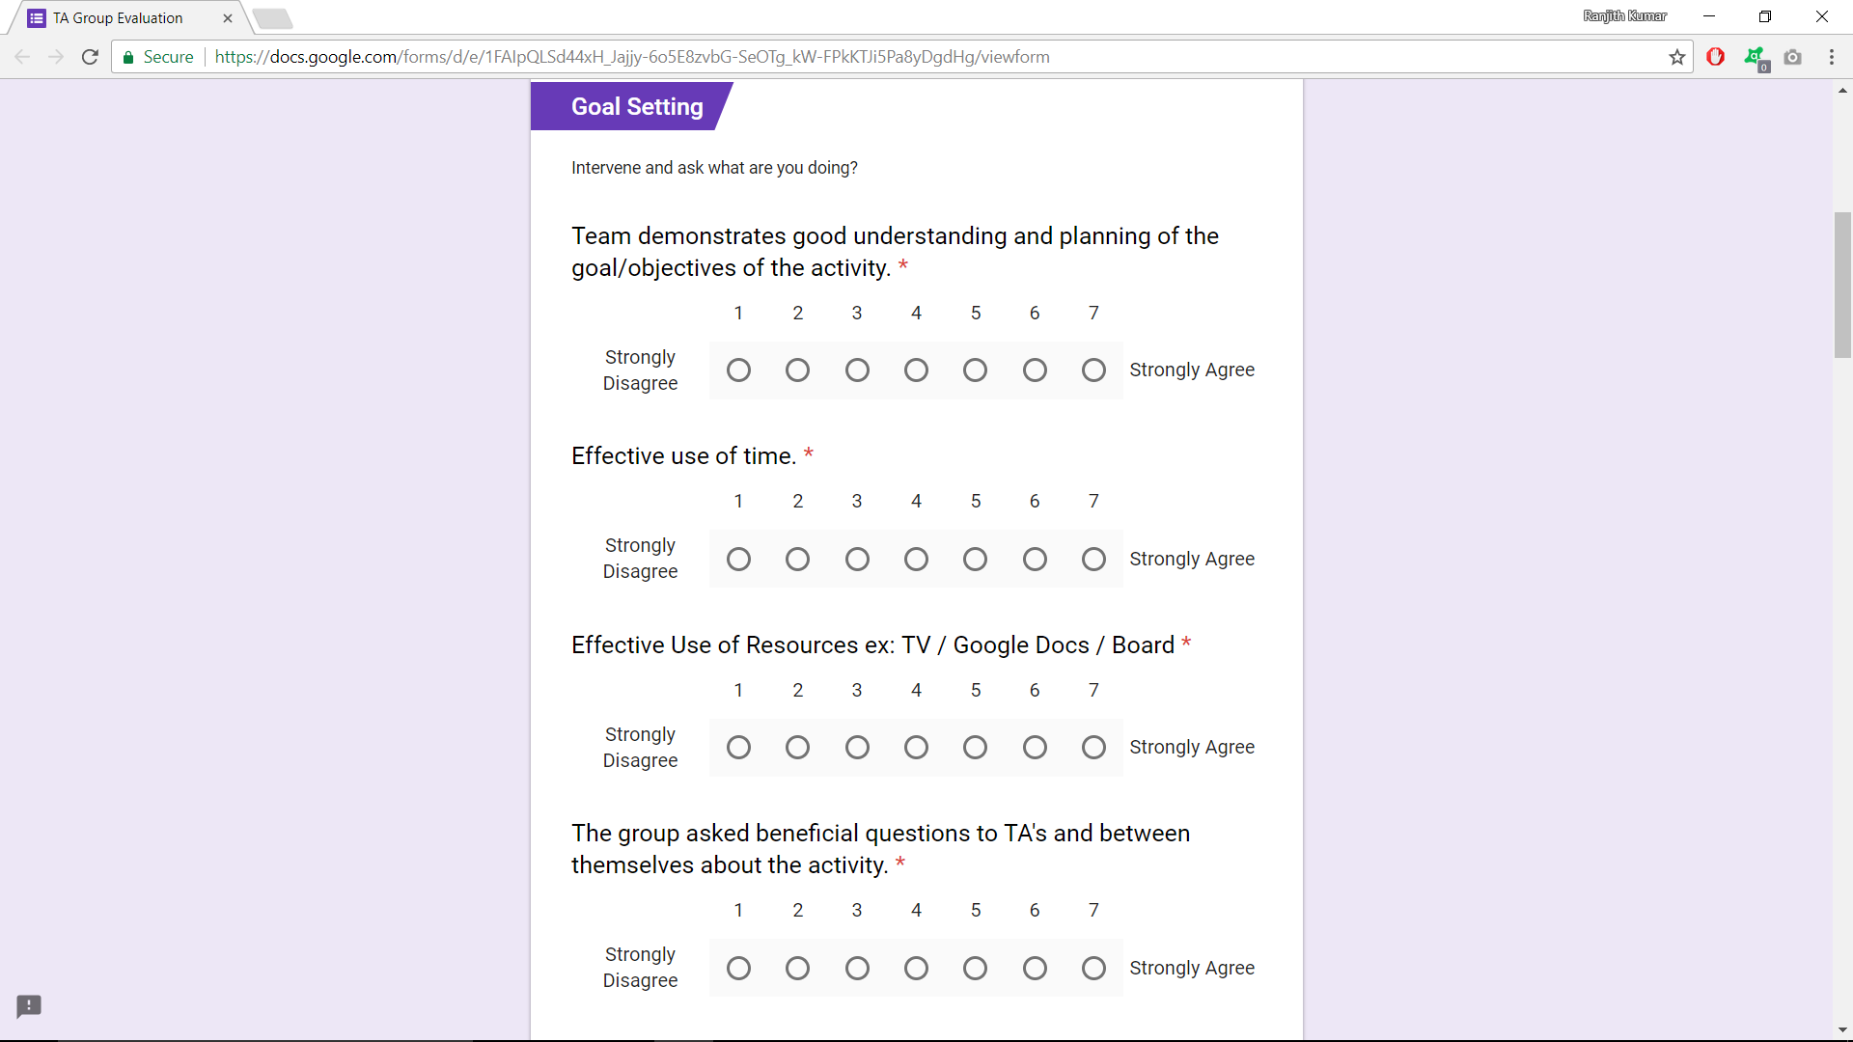

Slide 33
Data Analysis
Likert Scale questions
Group Cohesiveness Traits
Open-ended questions
Code book
Sentiment analysis
Correlations
Kahoot
Group-based activities

Slide 34
Group cohesiveness traits
Group cohesiveness (Likert-scale)
Goal settings
Communication
Trust
Accountability
Recognition

Slide 35
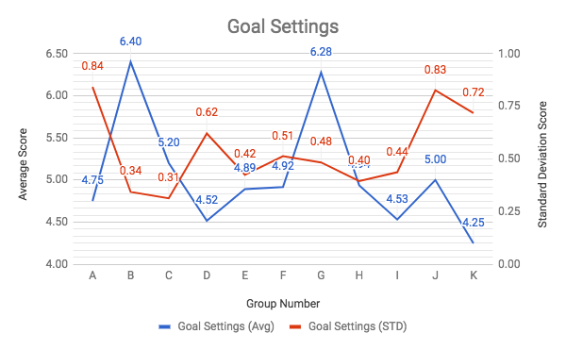

Slide 36
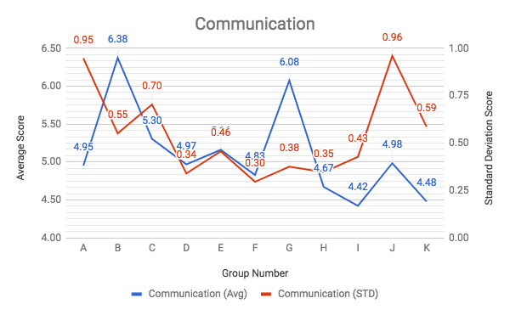
Communication Score

Slide 37
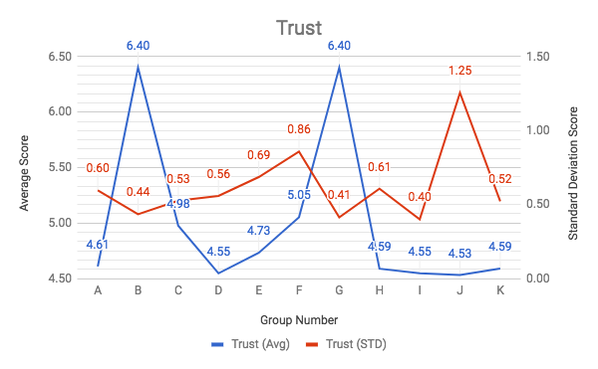
Trust

Slide 38
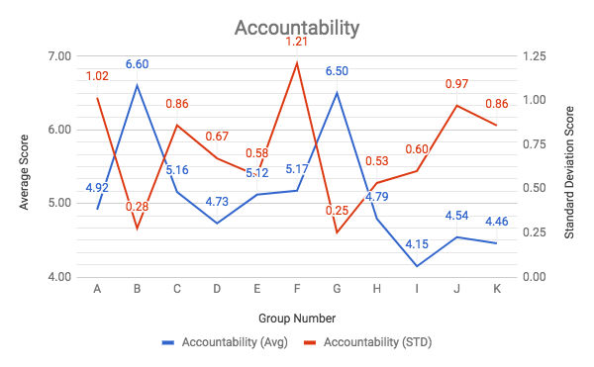

Slide 39
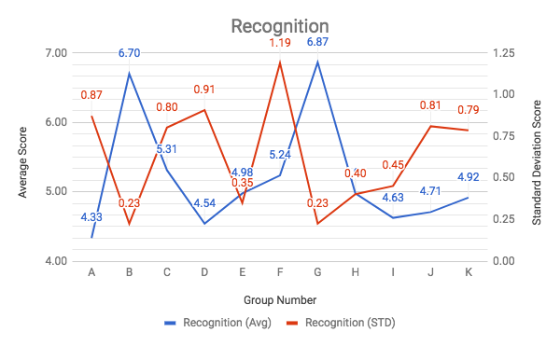

Slide 40
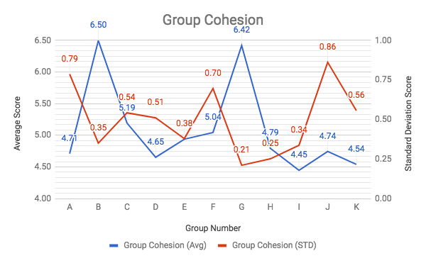

Slide 41
Analysis of open-ended
Open-ended
Code book
Reasons

Slide 42
Goal Settings | Communication | Trust | Accountability | Recognition | Observation
Active and engaged (GS1) | Good (C1) | Good (T1) | Entire-group (A1) | Good (R1)
Inactive and disengaged (GS2) | Bad (C2) | Bad (T2) | Half-group (A2) | Bad (R2) | Bad (O2)
 | Neutral (C3) | Neutral (T3) | No-group (A3) | Neutral (R3)

Slide 43
Code | Reasons
A1 | Responsible discussion about class activities
 | Concluding discussion to a common solution
 | Motivating themselves when they answered wrong
 | Discussing where they made a mistake
A2 | Less participation
 | Less discussion incorrect answers/understanding
 | Less responsibilities delegation
A3 | Not paying attention
 | No discussion
 | No participation
C1 | Discussion about class activities
 | Signs of leaderships
C2 | Discussion about non-class activities
 | Signs of Domination
 | Working alone
 | Group is mostly silent
 | Signs of Shyness
 | Group members are completely silent
C3 | Discussion in pairs

Slide 44
Code | Reasons
GS1 | Focused, engaged and interactive
 | Raising doubts/questions to TA
 | Effective use of class resources
 | Group enjoyed Kahoot
GS2 | Asked off-topic questions to TA
 | Dependency (Unable to function without leader of the group)
 | Didn't ask TA any questions
 | Distracted in non-class activities
 | Free-riding group members (Relying on group to get the work done with min/zero contributions)
 | Not listening to instructor/TA
 | Unable to ask TA any questions even when struggling with the activities
 | Signs of cluelessness about the activity
O2 | Disrespecting TA (Being condescending/rude to TA)
 | Group member absent
 | Group member came late
R1 | No signs of disapproval (Happy, excited, compassion towards the group and/or the activities)
R2 | Signs of disapproval (Unhappy and hopeless towards the group and/or the activities)
R3 | Neutral appreciation (No signs of positive/negative emotions towards the group and/or the activities)
T1 | Preparedness
 | Signs of leadership
 | Healthy arguments
T2 | Unable to challenge the group opinions
 | Unable to trust the group opinions

Slide 45
Social factors from open-ended
Open-ended
Goal settings
Communication
Trust
Accountability
Recognition
Others

Slide 46
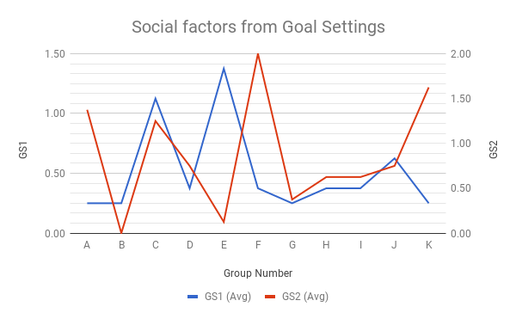
Social factors from Goal Settings

Slide 47
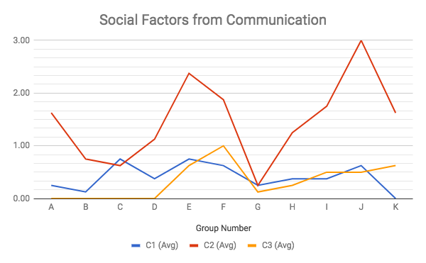
Social factors from communication

Slide 48
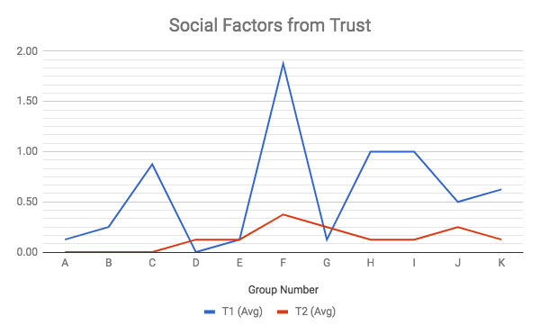
Social factors from trust

Slide 49
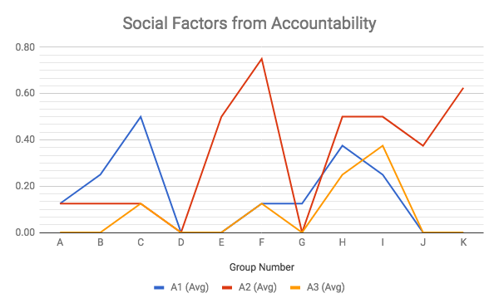
Social factors from accountability

Slide 50
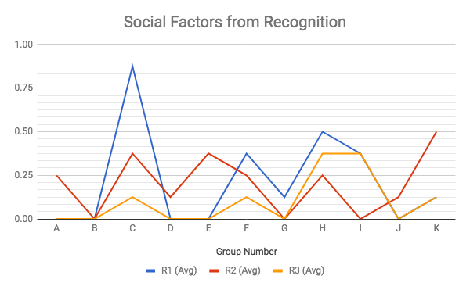
Social factors from Recognition

Slide 51
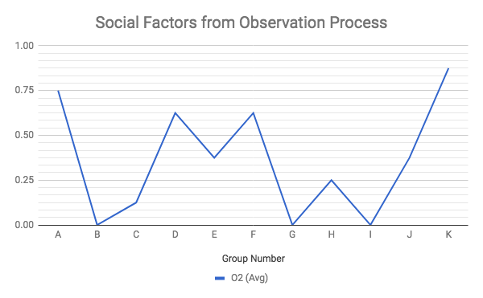
Observation process

Slide 52
Open-ended analysis
Sentiment-analysis
Positive emotions
Negative emotions

Slide 53
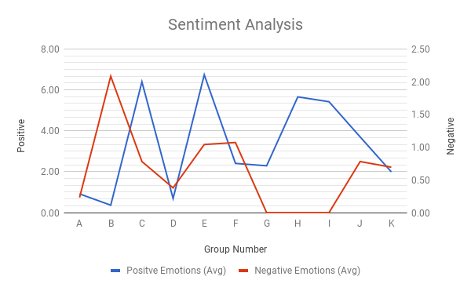
Sentiment analysis

Slide 54
Performance
Students performance
Group activities
Kahoot

Slide 55
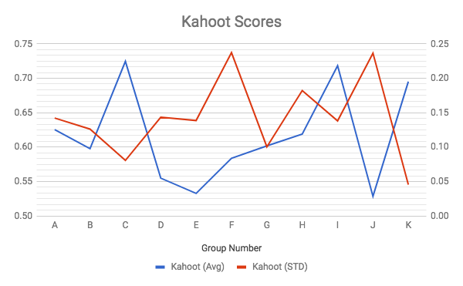
Kahoot scores

Slide 56
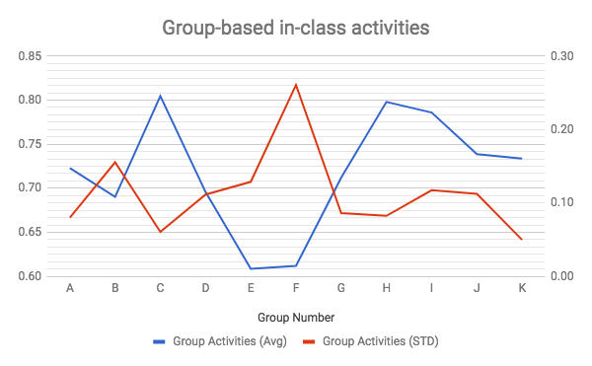
Group activities score

Slide 57
Correlations with performance
Kahoot Activities
Social Factors (open-ended)
Group cohesiveness (Likert-scale)
LIWC tool
Goal settings
Communication
Trust
Accountability
Recognition
Factors from code book
Sentiment Analysis

Slide 58
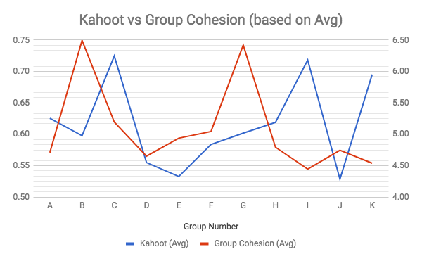
Kahoot vs Group cohesion
 |  | Pearson Coefficient (based on average) |  | Spearman's Rho (based on avg)
 |  | R value | R^2 value (coefficient determination) | R value | Two-tailed value of P
Kahoot | Group Cohesion | -0.15 | 0.02 | -0.22 | 0.51
 | Goal Settings | -0.19 | 0.04 | -0.14 | 0.69
 | Communication | -0.27 | 0.07 | -0.37 | 0.27
 | Trust | -0.09 | 0.01 | 0.05 | 0.89
 | Accountability | -0.23 | 0.05 | -0.20 | 0.55
 | Recognition | -0.05 | 0.00 | -0.02 | 0.95

Slide 59
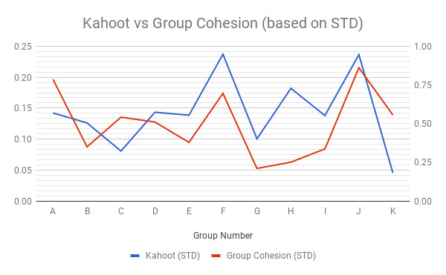
 |  | Pearson Coefficient (based on std) |  | Spearman's Rho (based on std)
 |  | R value | R^2 value (coefficient determination) | R value | Two-tailed value of P
Kahoot | Group Cohesion | 0.40 | 0.16 | 0.27 | 0.42
 | Goal Settings | 0.20 | 0.04 | 0.27 | 0.43
 | Communication | 0.01 | 0.00 | -0.26 | 0.45
 | Trust | 0.75 | 0.56 | 0.73 | 0.01
 | Accountability | 0.38 | 0.15 | 0.35 | 0.30
 | Recognition | 0.32 | 0.10 | 0.43 | 0.19

Slide 60
 |  | Pearson Coefficient (based on average) |  | Pearson Coefficient (based on std) |  | Spearman's Rho (based on avg) |  | Spearman's Rho (based on std)
 |  | R value | R^2 value (coefficient determination) | R value | R^2 value (coefficient determination) | R value | Two-tailed value of P | R value | Two-tailed value of P
Kahoot | GS1 | -0.12 | 0.01 | -0.03 | 0.00 | -0.30 | 0.36 | 0.36 | 0.28
 | GS2 | 0.33 | 0.11 | -0.17 | 0.03 | 0.25 | 0.46 | -0.10 | 0.77
 | C1 | -0.26 | 0.07 | 0.77 | 0.59 | -0.31 | 0.36 | 0.80 | 0.00
 | C2 | -0.40 | 0.16 | 0.43 | 0.18 | -0.40 | 0.23 | 0.56 | 0.07
 | C3 | -0.13 | 0.02 | 0.29 | 0.08 | -0.20 | 0.55 | 0.34 | 0.31
 | T1 | 0.32 | 0.10 | 0.00 | 0.00 | 0.42 | 0.19 | 0.03 | 0.92
 | T2 | -0.41 | 0.16 | 0.42 | 0.18 | -0.50 | 0.12 | 0.49 | 0.12
 | A1 | 0.60 | 0.36 | -0.11 | 0.01 | 0.64 | 0.03 | -0.12 | 0.73
 | A2 | 0.08 | 0.01 | 0.39 | 0.15 | 0.07 | 0.83 | 0.45 | 0.17
 | A3 | 0.54 | 0.29 | 0.21 | 0.04 | 0.52 | 0.10 | 0.26 | 0.44
 | R1 | 0.21 | 0.04 | 0.00 | 0.00 | 0.63 | 0.04 | -0.08 | 0.82
 | R2 | 0.21 | 0.04 | -0.24 | 0.06 | 0.12 | 0.72 | -0.18 | 0.60
 | R3 | 0.57 | 0.33 | -0.04 | 0.00 | 0.64 | 0.03 | 0.04 | 0.90

Slide 61
 |  | Pearson Coefficient (based on average) |  | Pearson Coefficient (based on std) |  | Spearman's Rho (based on avg) |  | Spearman's Rho (based on std)
 |  | R value | R^2 value (coefficient determination) | R value | R^2 value (coefficient determination) | R value | Two-tailed value of P | R value | Two-tailed value of P
Kahoot | Positive Emotions | 0.22 | 0.05 | -0.12 | 0.02 | 0.05 | 0.87 | -0.08 | 0.81
 | Negative Emotions | -0.26 | 0.07 | 0.01 | 0.00 | -0.42 | 0.20 | 0.03 | 0.94

Slide 62
Correlations with performance
Group-based Activities
Social Factors (open-ended)
Group cohesiveness (Likert-scale)
Sentiment Analysis
Goal settings
Communication
Trust
Accountability
Recognition
Factors from code book
LIWC tool

Slide 63
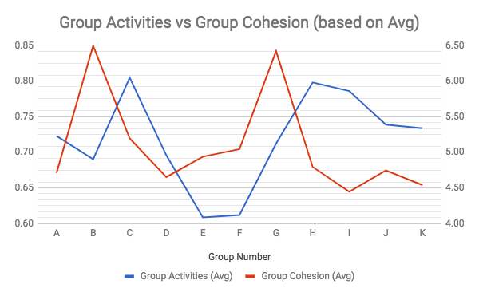
 |  | Pearson Coefficient (based on average) |  | Spearman's Rho (based on avg)
 |  | R value | R^2 value (coefficient determination) | R value | Two-tailed value of P
Group Activities | Group Cohesion | -0.20 | 0.04 | -0.31 | 0.35
 | Goal Settings | -0.10 | 0.01 | 0.01 | 0.97
 | Communication | -0.22 | 0.05 | -0.33 | 0.32
 | Trust | -0.20 | 0.04 | 0.45 | 0.17
 | Accountability | -0.31 | 0.09 | -0.49 | 0.13

Slide 64
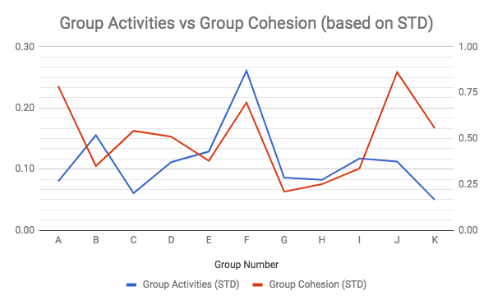
 |  | Pearson Coefficient (based on std) |  | Spearman's Rho (based on std)
 |  | R value | R^2 value (coefficient determination) | R value | Two-tailed value of P
Group Activities | Group Cohesion | 0.16 | 0.03 | -0.08 | 0.82
 | Goal Settings | -0.17 | 0.03 | -0.15 | 0.67
 | Communication | -0.38 | 0.15 | -0.41 | 0.21
 | Trust | 0.31 | 0.10 | 0.18 | 0.59
 | Accountability | 0.25 | 0.06 | -0.08 | 0.82

Slide 65
 |  | Pearson Coefficient (based on average) |  | Pearson Coefficient (based on std) |  | Spearman's Rho (based on avg) |  | Spearman's Rho (based on std)
 |  | R value | R^2 value (coefficient determination) | R value | R^2 value (coefficient determination) | R value | Two-tailed value of P | R value | Two-tailed value of P
Group Activities | GS1 | -0.15 | 0.02 | 0.05 | 0.00 | 0.12 | 0.73 | 0.29 | 0.39
 | GS2 | 0.00 | 0.00 | -0.12 | 0.01 | 0.14 | 0.68 | -0.47 | 0.15
 | C1 | -0.17 | 0.03 | 0.83 | 0.68 | 0.03 | 0.93 | 0.61 | 0.04
 | C2 | -0.27 | 0.08 | 0.21 | 0.04 | -0.17 | 0.61 | 0.18 | 0.59
 | C3 | -0.45 | 0.21 | 0.33 | 0.11 | -0.20 | 0.55 | 0.34 | 0.30
 | T1 | 0.06 | 0.00 | 0.01 | 0.00 | 0.40 | 0.22 | -0.27 | 0.43
 | T2 | -0.42 | 0.18 | 0.32 | 0.10 | -0.24 | 0.47 | 0.32 | 0.33
 | A1 | 0.62 | 0.39 | -0.09 | 0.01 | 0.50 | 0.12 | -0.12 | 0.73
 | A2 | -0.21 | 0.04 | 0.38 | 0.14 | -0.02 | 0.96 | 0.30 | 0.36
 | A3 | 0.50 | 0.25 | 0.17 | 0.03 | 0.51 | 0.11 | 0.04 | 0.91
 | R1 | 0.54 | 0.29 | 0.21 | 0.04 | 0.57 | 0.07 | -0.22 | 0.51
 | R2 | -0.06 | 0.00 | -0.26 | 0.07 | 0.08 | 0.81 | -0.47 | 0.15
 | R3 | 0.56 | 0.32 | -0.02 | 0.00 | 0.58 | 0.06 | -0.22 | 0.52

Slide 66
 |  | Pearson Coefficient (based on average) |  | Pearson Coefficient (based on std) |  | Spearman's Rho (based on avg) |  | Spearman's Rho (based on std)
 |  | R value | R^2 value | R value | R^2 value | R value | Two-tailed P | R value | Two-tailed P
Group Activities | Positive Emotions | 0.28 | 0.08 | -0.10 | 0.01 | 0.36 | 0.28 | -0.21 | 0.54
 | Negative Emotions | -0.48 | 0.23 | 0.41 | 0.17 | -0.56 | 0.07 | 0.48 | 0.13

Slide 67
Correlations with performance
Final correlation
Over all grades (dependent)
Kahoot
Group-based activities
Selected Factors (independent)
C1
T1
R3
A1

Slide 68
Based on Avg |  | Based on STD
Dependent Variables | Independent Variables | Dependent Variable | Independent Variables
Over all grades(y) | T1 C1 A1 R3 | Over all grades(y) | T1 C1 A1 R3
Multiple R | 0.865487 | Multiple R | 0.890138

Slide 69
Conclusion
Data analysis
Group Cohesion and its traits
Social factors from the open-ended answers
Sentiment analysis for each group
How it affects Group activities and Kahoot

Slide 70
Future work
Students’ opinions regarding group cohesion and directly correlate with
Academic grades
Correlate between students’ and TAs’ perspective about
Group Cohesion
Social factors

Slide 71
Thank you so much for your time.

